Slide 1

Analyzing spatial distributions using Ripley-K function
Youran Tao Jensen
Supervisor: François Bernard Lauze
23.06.2023

Slide 2
Introduction
The main objective of this project is to analyze spatial point processes using the Ripley-K function and investigate its behavior under different distribution settings.
Developing algorithms for sampling spatial point processes, computing the Ripley-K function on a triangle mesh, and applying the function to real-world datasets.

Slide 3
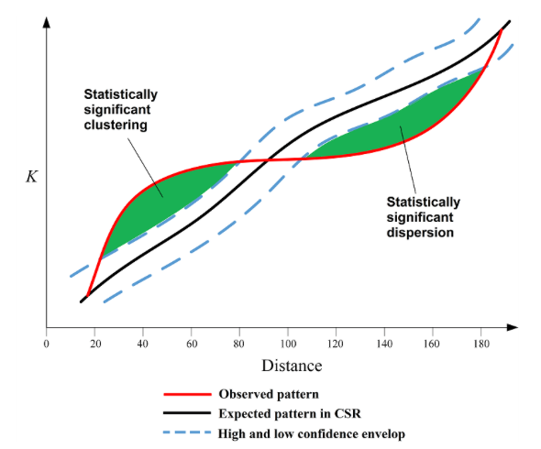
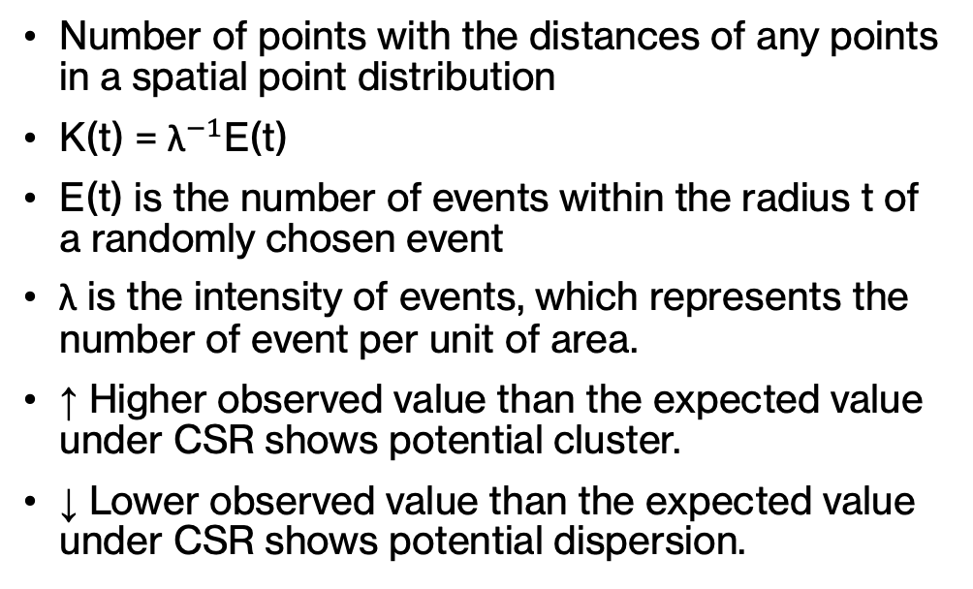
Ripley-K function
Number of points with the distances of any points in a spatial point distribution
$\text{K}\text{(}\text{t}\text{) = }{\text{λ}}^{−1}\text{E}\text{(}\text{t}\text{)}$
E(t) is the number of events within the radius t of a randomly chosen event
λ is the intensity of events, which represents the number of event per unit of area.
↑ Higher observed value than the expected value under CSR shows potential cluster.
↓ Lower observed value than the expected value under CSR shows potential dispersion.
Notes:
Animation – search circle, ki=E(t)

Slide 4
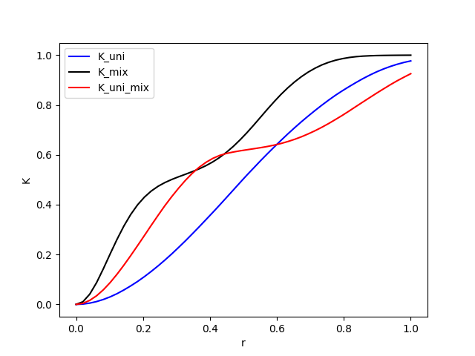
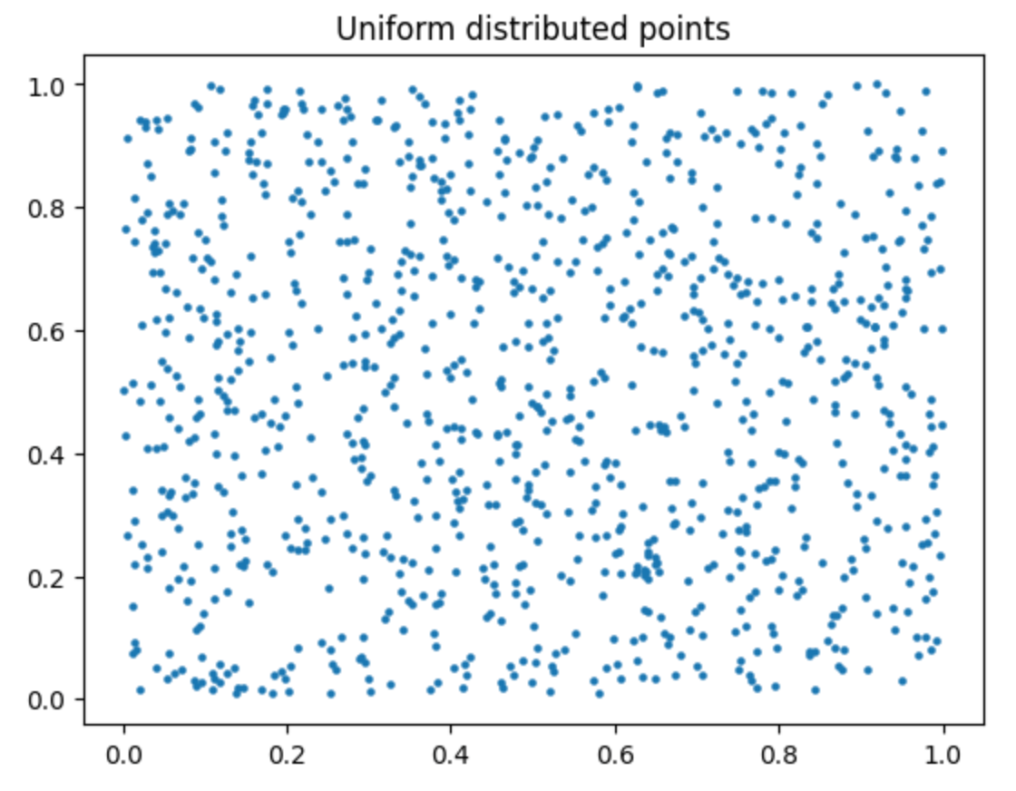
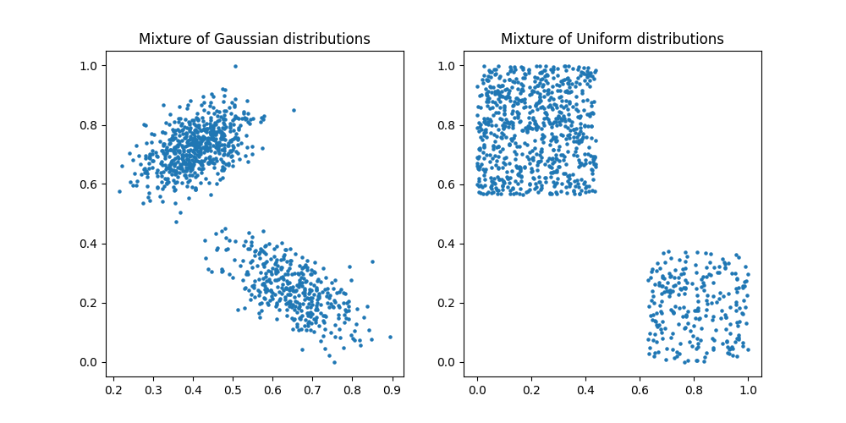
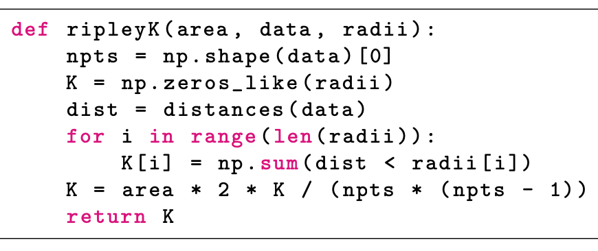
Ripley-K function for 2D space
Notes:
Black is gaussian, for loop count how many points is within the search radios, radii = radios of search circal, npts = number og points, K = lamda^-1

Slide 5
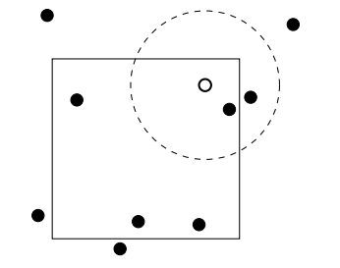
Ripley-K with edge correction
Edge effects can introduce bias and distort the analysis of point distributions if reference points are located too close to the boundary of the observable space.
Points outside the boundary may not be counted, even if they are within the search circle.
Ignore the points that are in close proximity to the edge.
Creating pseudo-points outside the boundary.

Slide 6
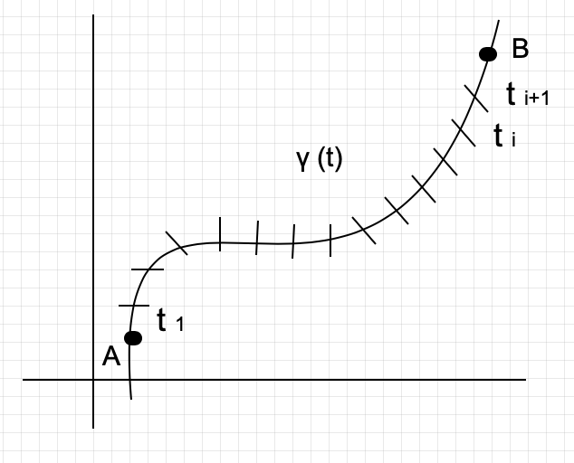
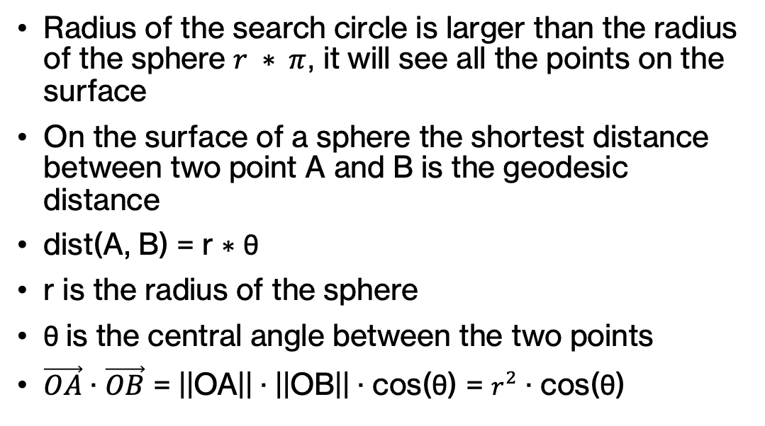
Ripley-K function on a sphere
Radius of the search circle is larger than the radius of the sphere $r ∗ π$, it will see all the points on the surface
On the surface of a sphere the shortest distance between two point A and B is the geodesic distance
$\text{dist}\text{(}\text{A}\text{, }\text{B}\text{) = }\text{r}\text{ ∗ }\text{θ}$
r is the radius of the sphere
$\text{θ}$is the central angle between the two points
$\vec{OA}$ $\text{·}$ $\vec{OB}$ $\text{= ||}\text{OA}\text{|| · ||}\text{OB}\text{|| · }\text{cos}\text{(}\text{θ}\text{) = }r^{2}\text{ · }\text{cos}\text{(}\text{θ}\text{)}$
Notes:
Missing equalsion for teta

Slide 7
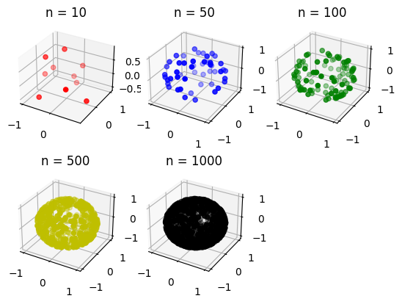
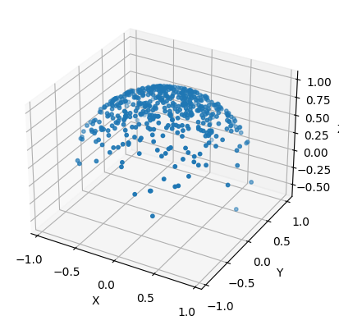
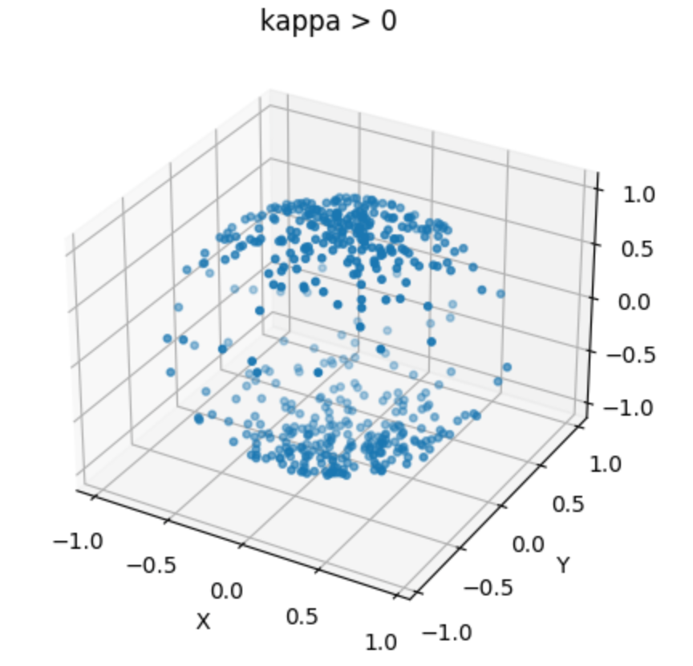
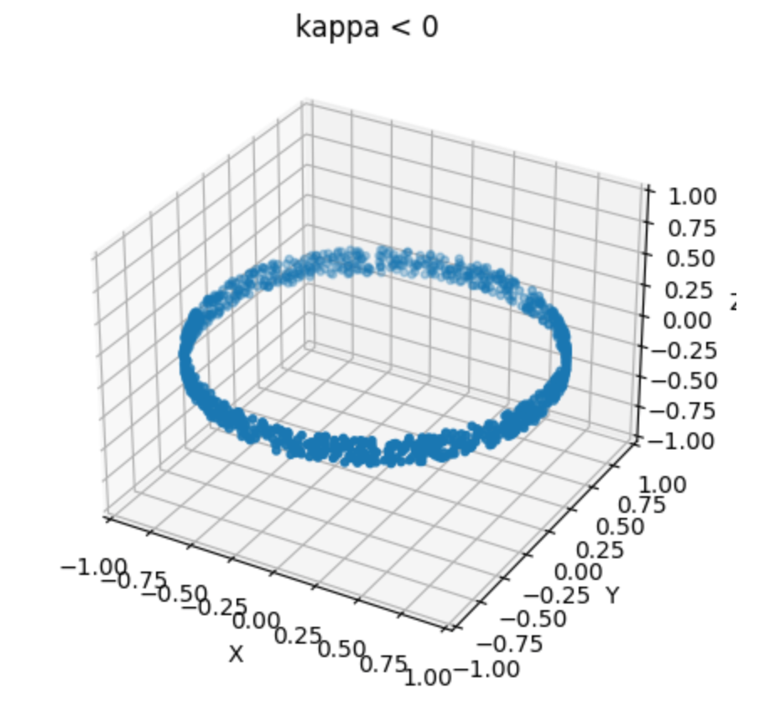
Simulation of a point process on spherical surface
Uniform distribution
von Mises–Fisher
Watson distribution

Slide 8
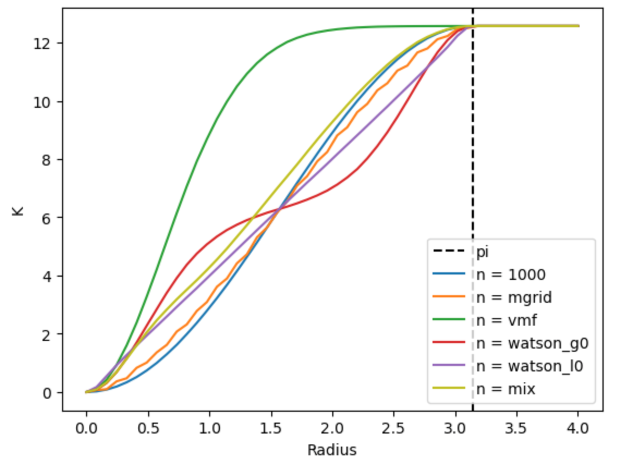
Notes:
Add something later

Slide 9
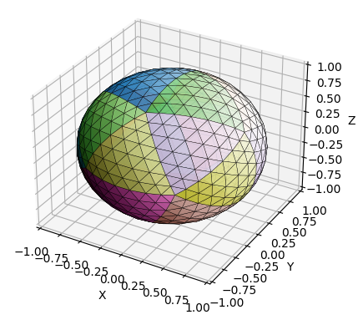
Ripley-K function on a mesh
Icosahedron
Uniform sampling on triangular mesh
Barycentric coordinates
Geodetic distance on mesh
Projecting the point on to the mesh

Slide 10
Ripley-K function on a mesh
Closest vertices to both the source and target point are determined
Geodesic distances between them along the surface of the mesh are computed
Evaluate the spatial distribution of these points on the mesh using Ripley-K function

Slide 11
Fast Marching Method
Initialize a priority queue and a list for the distances to each of the vertices
Marking the the source point as "visited"
Adding all its neighbour vertices to the priority queue
Distances to the neighbouring vertices are calculated, and the smallest of these neighbours is removed from the priority queue and mark as "visited".
Neighbours of the this vertex that have not yet been visited is adding the queue,
For each of these neighbours, the algorithm compute the cost of reaching it from the source vertex, if it is lower than the previously known distance, then the cost is update to the lower value

Slide 12
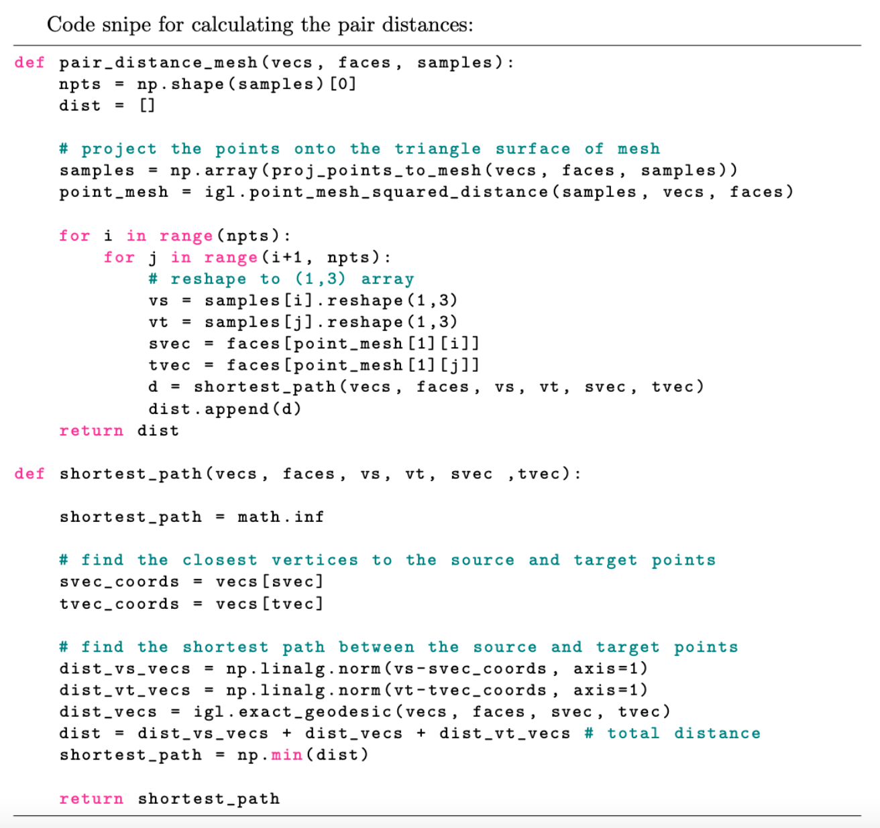
Pair Distances between two points on mesh
Notes:
Draw a pictur to illustra it

Slide 13
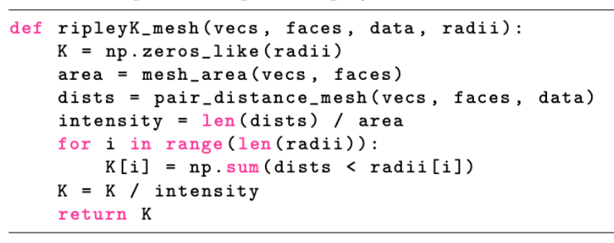
Ripley-K for triangular mesh
Compute the surface area of the mesh
Determine the search radii: 50 search circles with radius from 0 to 4
Compute the pair distance for all points
Normalized the Ripley-K value by dividing it with the intensity

Slide 14
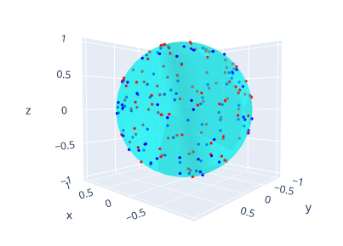
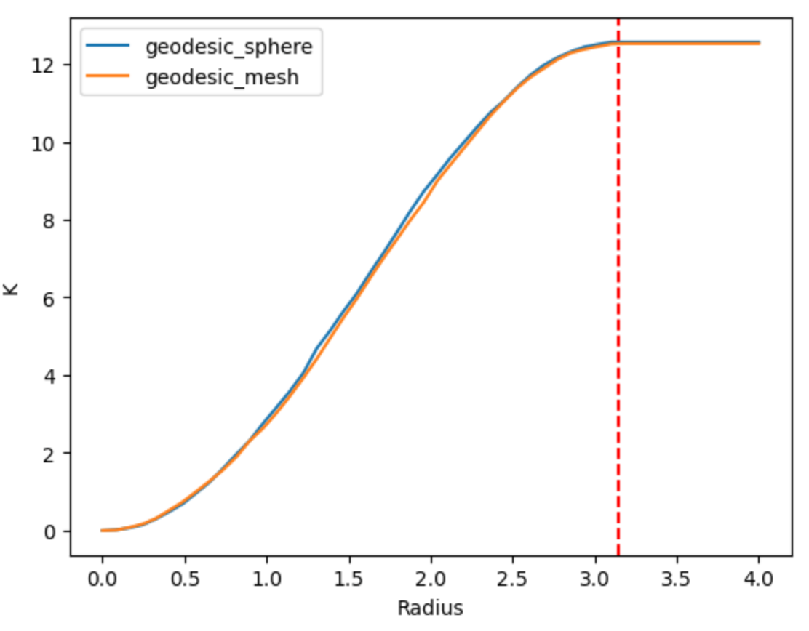
Ripley-K for uniform samples on geometric mesh
Spherical mesh created using the icosphere
Red points represent samples using the mesh-based method - geodesic mesh distance
Blue points are sampled with spherical formula - great-circle distance

Slide 15
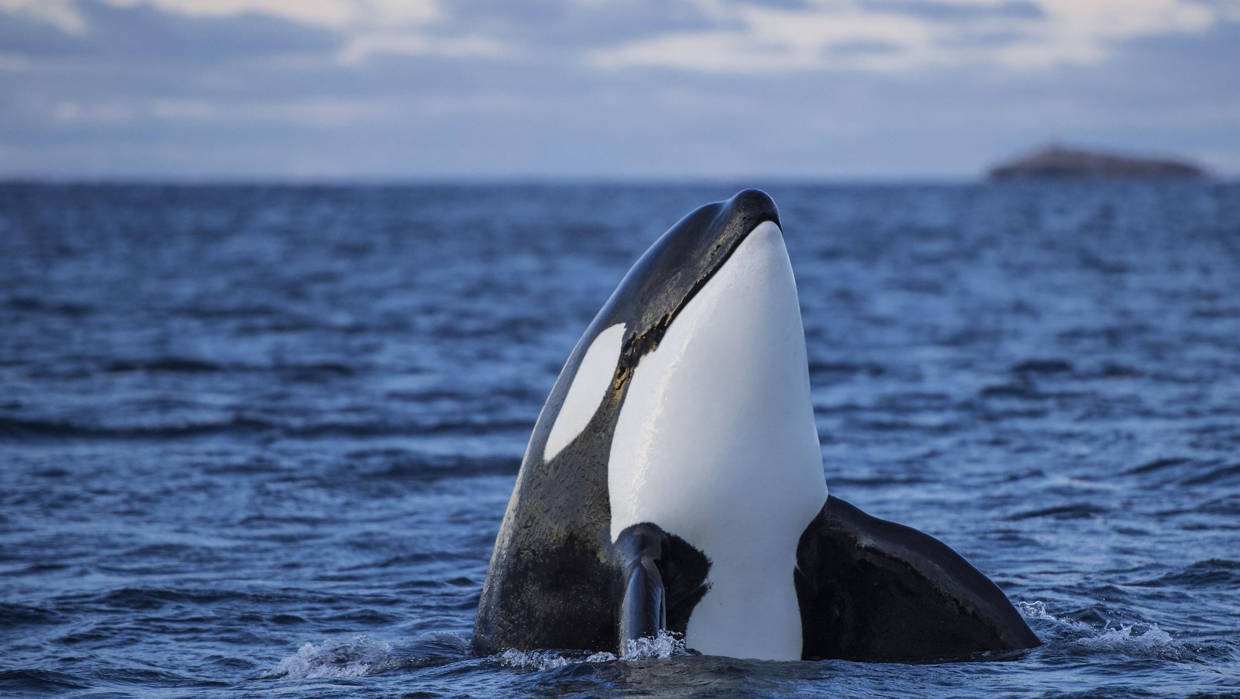
Ripley-K function for whale location

Slide 16
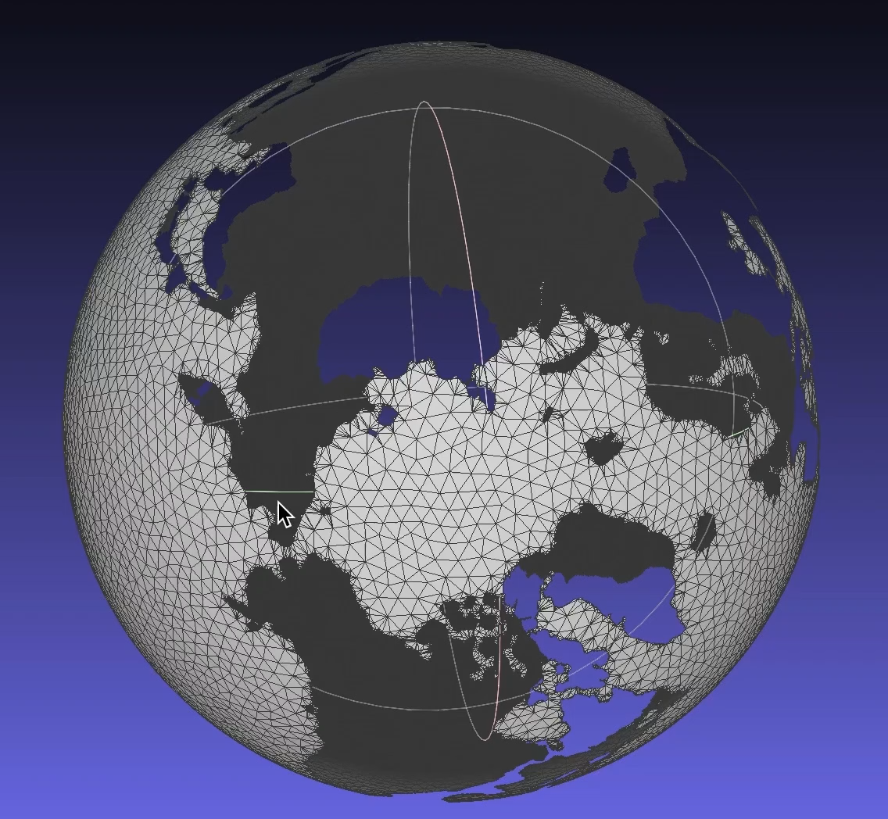
Mesh data for earth without continents
Gray scale map with two classes was chosen, 1 for the sea and 0 for the land
All the small elements were removed, such as the islands in the pacific ocean
Using a program to get the list of coordinate and mapping the to map together

Slide 17
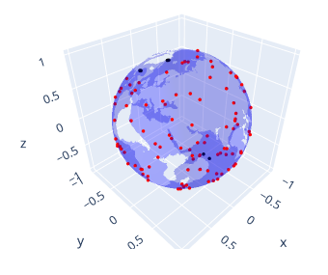
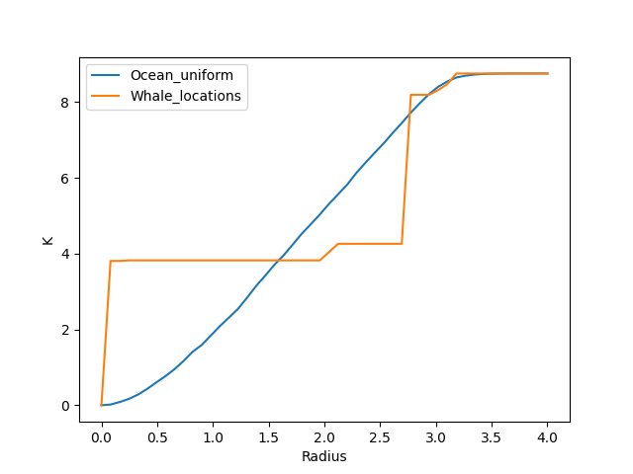
Ripley-K function for whale location
Sampling real world data points on the ocean mesh
Ripley-K function for whale location shows that the location of whales are distributed in two major clusters
Whale are primary located on the coast of California and Mexico gulf

Slide 18
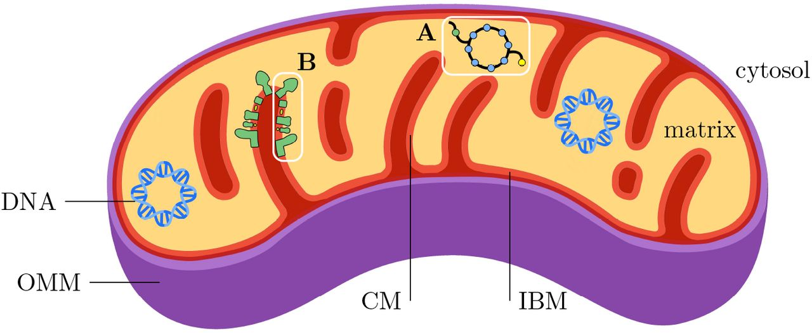
Crista junctions location on mitochondria
Projected points that were located on the plane spanned by the triangle, but lay outside of the triangle region
Closest vertex on the mesh as projections point
Simulate where crista are attached on the membrane of mitochondria
Compute the distance from a source point to all other points

Slide 19
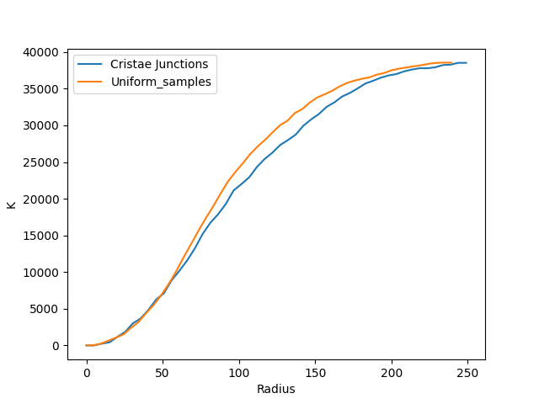
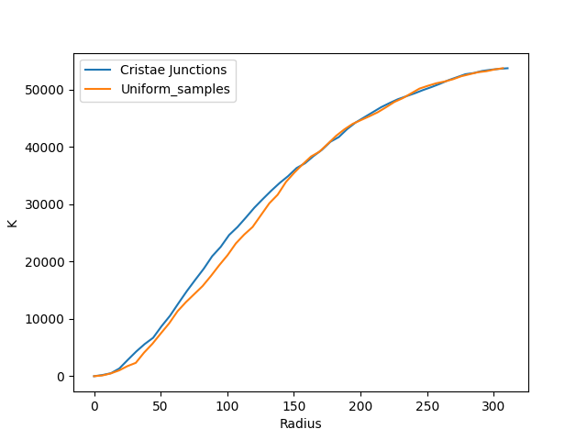
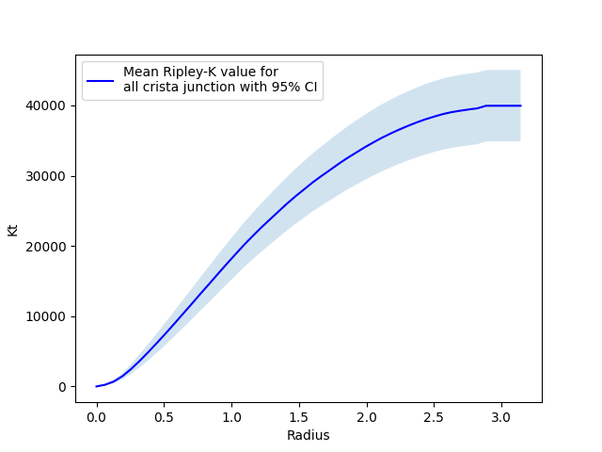
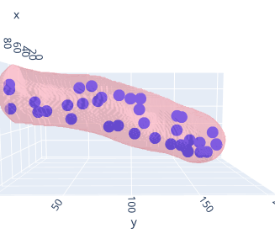
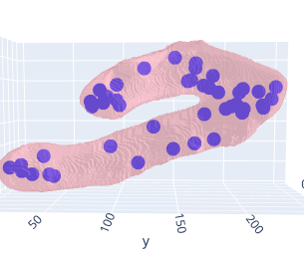
Simulation

Slide 20
Conclusion
We studied Ripley-K function and its uses in analyzing the spatial distribution of points in various settings.
Overview of the Ripley-K function and its applications in different scenarios

